Slide 1

Conversational QA

Slide 2
Conversational Question Answering
[Reddy et al. ‘18]
Questions and answers in free-form text
Different forms, different challenges
Chit Chat
Multi-turn QA
Clarifications
Different from MRC:
Isolated vs contextual
Question lengths: shorter for conversational QA datasets (contextual)
Question Answering over Curated and Open Web Sources R. Saha Roy and A. Anand SIGIR 2020 Tutorial
26 July 2020

Slide 3

Conversational Question Answering (CoQA)
[Reddy et al. ‘18]
Multi-turn conversation, each turn is a question and an answer
Questions and answers in free-form text
Conversation is grounded in Passage
Concrete eval unlike chit-chat
127,000 questions and answers
8K conversations (avg. 15 turns)
7 diverse domains
Children stories, literature, exams, cnn news, Wikipedia
Hidden domains : reddit, science
Question Answering over Curated and Open Web Sources R. Saha Roy and A. Anand SIGIR 2020 Tutorial
26 July 2020

Slide 4
CoQA Dataset
[ Reddy ‘18]
The Virginia governor’s race, billed as the marquee battle of an otherwise anticlimactic 2013 election cycle, is shaping up to be a foregone conclusion. Democrat Terry McAuliffe, the longtime political fixer and moneyman, hasn’t trailed in a poll since May. Barring a political miracle, Republican Ken Cuccinelli will be delivering a concession speech on Tuesday evening in Richmond. In recent ...
Q1: What are the candidates running for?
Q2: Where?
Q3: Who is the democratic candidate?
Q4: Who is his opponent?
Q5: What party does he belong to?
Q6: Which of them is winning?
A1: Governor, R1: The Virginia governor’s race
A2: Virginia, R2: The Virginia governor’s race
A3: Terry McAuliffe, R3: Democrat Terry McAuliffe
A4: Ken Cuccinelli , R4 Republican Ken Cuccinelli
A5: Republican, R5: Republican Ken Cuccinelli
A6: Terry McAuliffe, R6: Democrat Terry McAuliffe, the longtime political fixer and moneyman, hasn’t trailed in a poll since May
Question Answering over Curated and Open Web Sources R. Saha Roy and A. Anand SIGIR 2020 Tutorial
26 July 2020
Notes:
Are interpretable-by-design models

Slide 5

Seq2Seq Abstractive Response Generation
[Reddy et al. ‘18]
context
Attention
distribution
vocabulary
distribution
Passage
q1
q2
<start>
Vocabulary over a fixed set of words
(also words not in the sentence)
The Virginia governor’s …
What are the candidates running for?
Where ?
Question Answering over Curated and Open Web Sources R. Saha Roy and A. Anand SIGIR 2020 Tutorial
26 July 2020
Notes:
At each time stamp find which words that are important to focus on. Take the context vector and the current word to

Slide 6
PGNet
[Reddy et al. ‘18]
Distributions over words only in the seen words
Copying
distribution
Next Word
context
Attention
distribution
vocabulary
distribution
Passage
q1
q2
<start>
The Virginia governor’s …
What are the candidates running for?
Where ?
Question Answering over Curated and Open Web Sources R. Saha Roy and A. Anand SIGIR 2020 Tutorial
26 July 2020
Notes:
At each time stamp find which words that are important to focus on. Take the context vector and the current word to

Slide 7
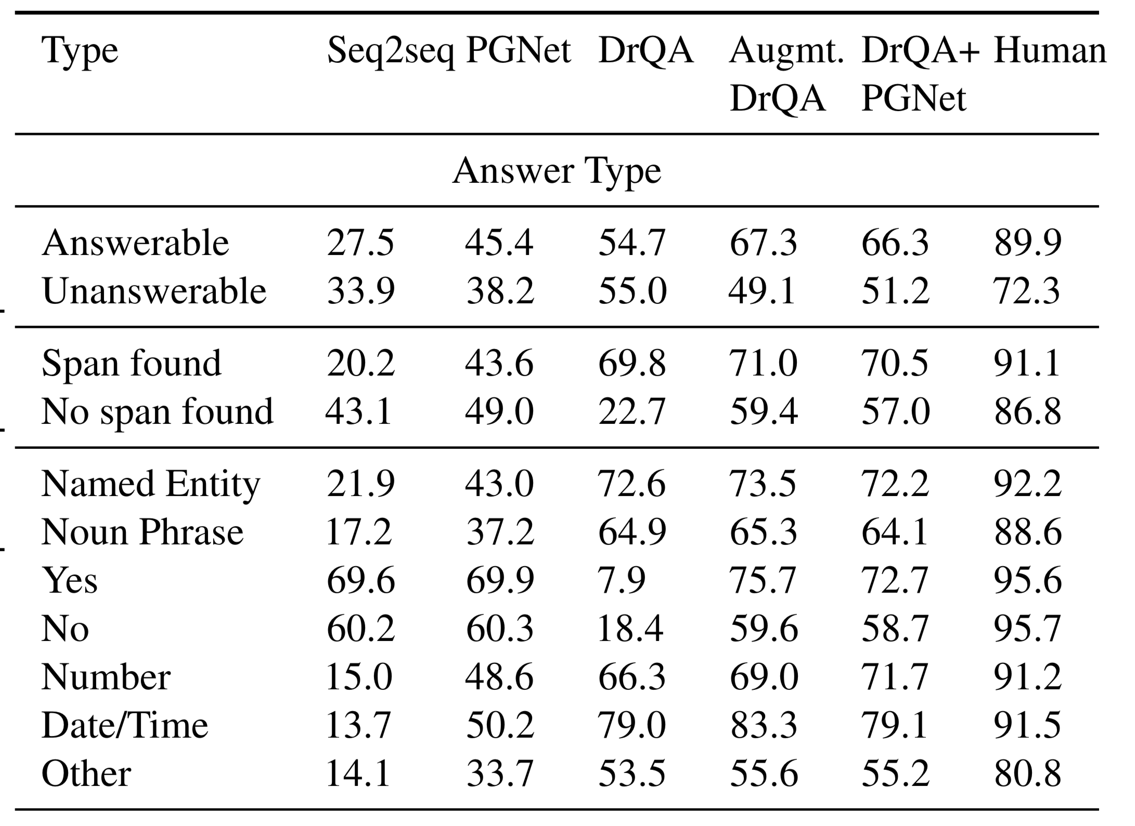

Hybrid Model
[Reddy et al. ‘18]
Extractive answer
Abstractive Answering
Seq2seq
Model
Question Answering over Curated and Open Web Sources R. Saha Roy and A. Anand SIGIR 2020 Tutorial
26 July 2020

Slide 8
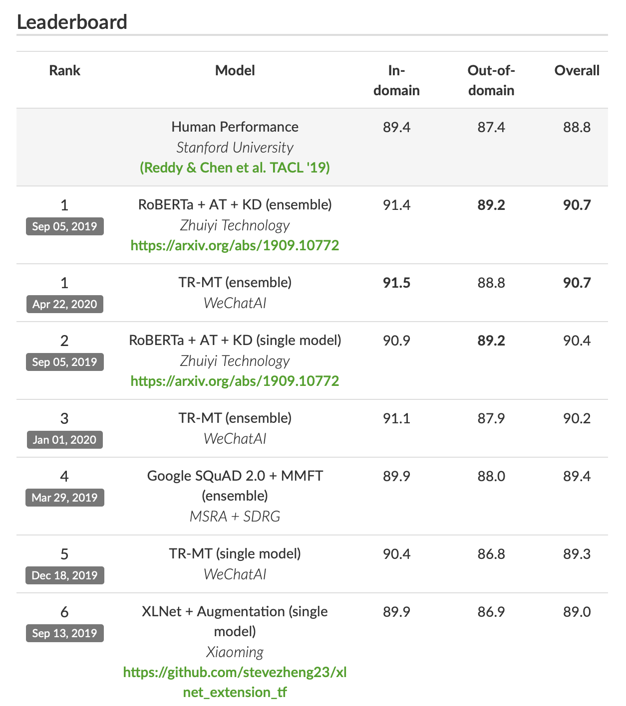
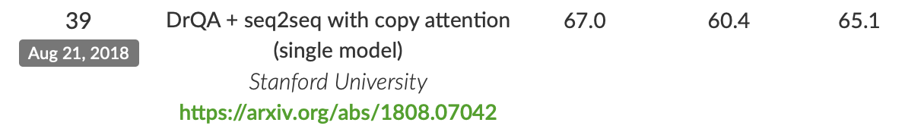
Leaderboard Sneakpeak
[Reddy et al. ‘18]
Question Answering over Curated and Open Web Sources R. Saha Roy and A. Anand SIGIR 2020 Tutorial
26 July 2020

Slide 9
Other Conversational Datasets
[Reddy et al. ‘18]
QuAC [Choi ’19]
Simulating info. seeking dialog
About a Wikipedia text
11k Dialogs, 98K QA Pairs
Simple evaluation
QuLAC [Aliannejadi ‘19]
Clarifying questions in info. Seeking conversations
Open domain, IR setting
198 topics [TREC Web Track]
Others: CSQA (Saha et al., 2018) CQA (Talmor and Berant, 2018) SQA (Iyyer et al., 2017)
Question Answering over Curated and Open Web Sources R. Saha Roy and A. Anand SIGIR 2020 Tutorial
26 July 2020

Slide 10
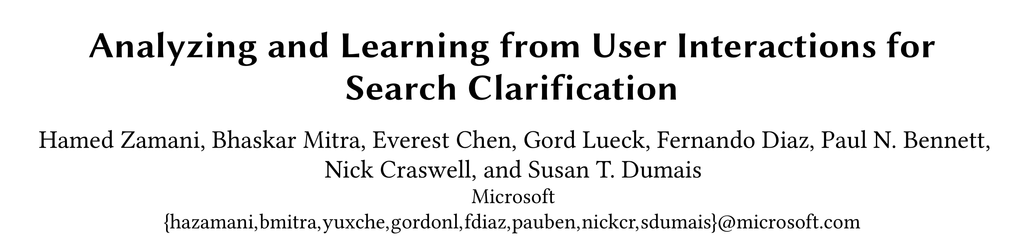
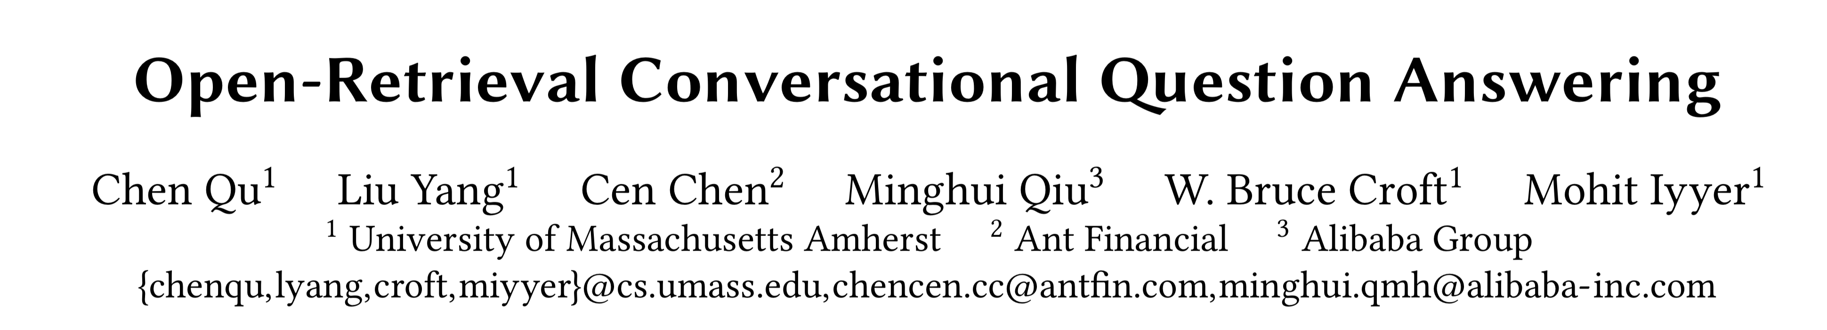

Some papers this SIGIR…
Question Answering over Curated and Open Web Sources R. Saha Roy and A. Anand SIGIR 2020 Tutorial
26 July 2020

Slide 11
Lessons learnt
Contextual representations for text go a long way
Using sparse training data in open-domain QA is important
Understanding your dataset is important
Aggregation
Multi-step reasoning
Anecdotal success and failure cases extremely valuable
Training neural models is an art and science in itself
Question Answering over Curated and Open Web Sources R. Saha Roy and A. Anand SIGIR 2020 Tutorial
26 July 2020
Notes:
Sparql – more than one answer – no problem

Slide 12
How to get started
Download your dataset of choice SQUAD, MSMarco, COQA
Implement simplest QA system that you can think of
Examine failure cases, analyse errors, get to know your datasets
Reimplement recent method of choice: Is it perfect?
Time for your own research!
Leaderboarding is valuable but not always reflective of true improvements
Question Answering over Curated and Open Web Sources R. Saha Roy and A. Anand SIGIR 2020 Tutorial
26 July 2020
Notes:
Sparql – more than one answer – no problem

Slide 13
Open problems
Efficiency
Open-domain QA at scale – recent advances but lots to discover
Interpretability
How can you go beyond feature attributions, selections
Interactivity
Multiple interaction paradigms – training and inference settings
Robustness
Question Answering over Curated and Open Web Sources R. Saha Roy and A. Anand SIGIR 2020 Tutorial
26 July 2020
Notes:
QA is not one big competition, be creative, be realistic

Slide 14

Conclusions
QA over text …
Text corpora are noisy but have more information coverage and redundancy
Efficiency and scalability in open-domain QA is a challenge
“Explainability” is important but often overlooked
Conversational Search is upcoming and has some crucial challenges
Question Answering over Curated and Open Web Sources R. Saha Roy and A. Anand SIGIR 2020 Tutorial
26 July 2020
Notes:
Write HIN

Slide 15
Thank you

